Slide 1
CS 120 Extra: The CS1 Server
Tarik Booker
CS 120

Slide 2
Topics
Accessing the Server
Navigating a Linux Environment
Basic Commands
Built in Text Editors
Transferring Documents
Displaying your Website

Slide 3
Accessing the CS1 Server
You should have received an account name and password from me in class
Your account is in the form of:
cs120sXX
Where “XX” is the number you are assigned

Slide 4
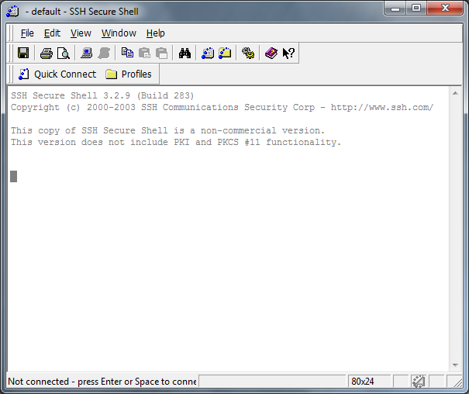
Accessing the CS1 Server (2)
You need SSH access to get into the CS1 Server
Stands for “Secure Shell”
A secure version of Telnet
Terminal access to a remote computer
The school has Secure Shell Client on its network
You will need this to access the server.

Slide 5
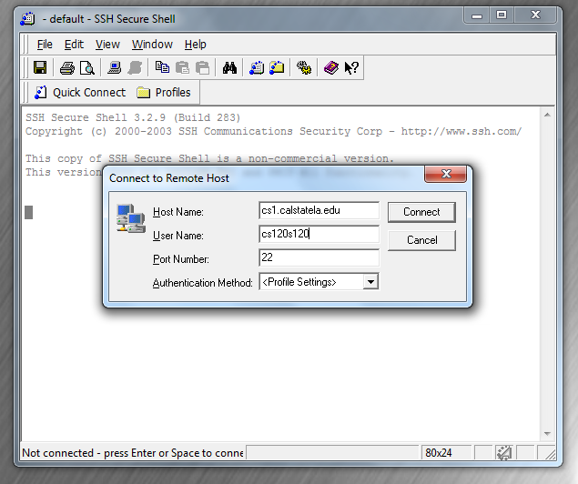
Accessing the CS1 Server (3)
When secure shell is open:
Connect to the CS1 Host:
cs1.calstatela.edu
Again, use your assigned student account
(This example is cs120s120)
You will then be prompted
to enter a password:
(You can save the public key
If you want)

Slide 6
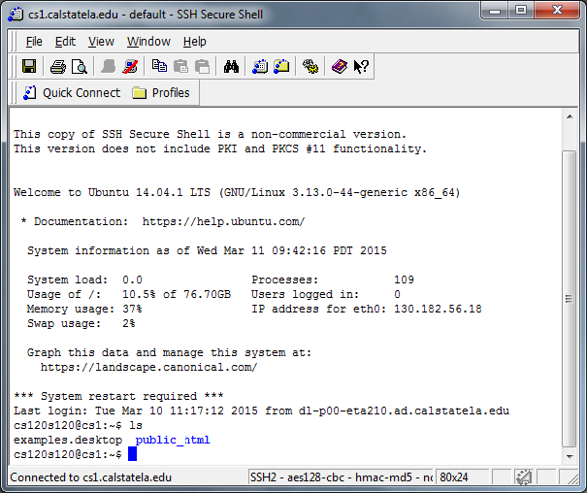
Accessing the CS1 Server (4)
Once you’re in the system, you will have to move everything to your public_html folder.
Type “ls” to list items in your account

Slide 7
Accessing the CS1 Server (5)
Congratulations! You’re in!
Next: Navigating a Linux Environment

Slide 8
Navigating a Linux Environment
The CS1 Server is actually a (powerful) Linux computer
Directly connected to the internet
Once you’re in, you’re essentially accessing a computer remotely
Called a “terminal”
Requires use of the “command-line”
Navigating the computer by typing in commands
Many different commands in Linux
Also possible on a Windows computer
Run “cmd”
Dos window (used before Windows)
Different commands in Windows, than on Linux

Slide 9

Linux!
Created (mostly) by Linus Torvalds in 1991
Free alternative operating system to UNIX
UNIX = professional workstation operating system
Completely Free, you can download your own version
Many Many Many versions out there
CS1 Runs “Ubuntu”
http://www.ubuntu.com/
http://en.wikipedia.org/wiki/Ubuntu_(operating_system)
Run your own, if you dare!

Slide 10
Linux Terminal Structure
Linux is just like your computer, only different.
File / Folder Structure is similar
Compare with relative URL’s
Note: Folders can also be called directories
Folder 1
File1
File2
Folder 2
Folder 3
Folder 2
Folder 3
File a
File b
File c
File x
File y
File z

Slide 11
Linux Terminal Structure (2)
The terminal moves from folder to folder
(or directory to directory)
You can use commands to change what folder (directory) the terminal is in
Can also do things to files within the current directory
Terminal Window
Folder
Folder
Folder
Folder
Folder
Folder

Slide 12
Basic Linux Terminal Commands
There are a few basic Linux commands that are useful:
Directory Commands:
ls list (display all files within a) directory
cd change directory
mkdir make (a) directory
rmdir remove (a) directory
pwd show the current directory
File Commands:
cp copy (a file)
mv move (a file)
rm remove (delete) a file

Slide 13
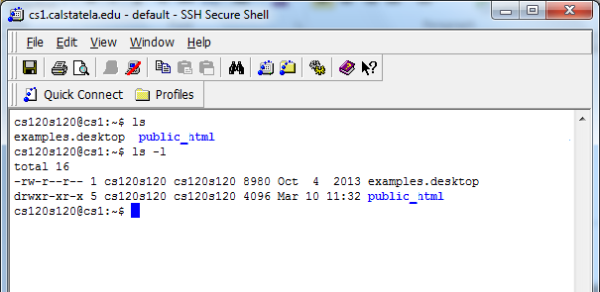
The ls Command
“List”
Display all files and folders contained within the current directory
The directory the terminal is currently in
Type in “ls -l” (dash l) to display a “long” view of the files

Slide 14
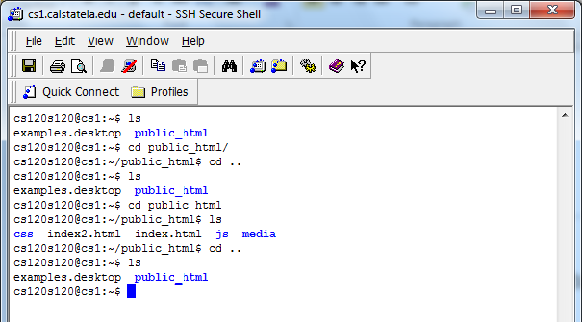
The cd Command
“Change Directory”
Moves the terminal to whatever directory (folder) you specify
cd [name_of_folder]
Type “cd public_html” to move into the public_html folder.
This folder will contain your website
Type “cd ..” to move back into the “parent directory”
The folder “above” your folder
Note: I made these folders in class:

Slide 15
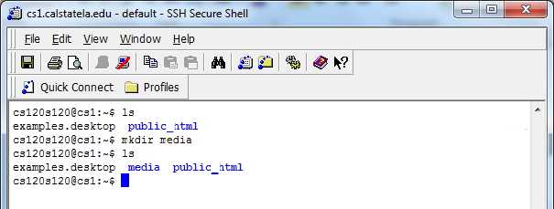
The mkdir Command
“Make Directory”
Create a new directory (folder) within whatever folder your terminal is currently at
mkdir [folder_name]
Creates a new folder with the name you specify
“mkdir media” creates a new folder named media (within whatever folder the terminal is in)

Slide 16
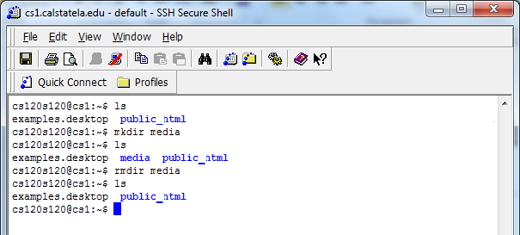
The rmdir Command
“Remove directory”
Removes whatever directory you name
rmdir [directory_name]
“rmdir media” removes the folder I created
Note: You will not be able to remove folders that currently have files contained within!
Remove the files first before you delete the folder!

Slide 17
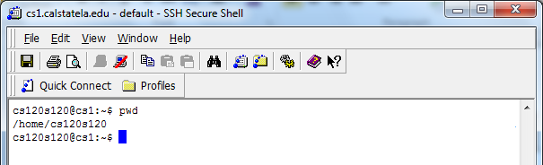
The pwd Command
“Print working directory”
Shows the full pathname of the folder you’re in
“pwd”
Note: This is the pathway of the folder on the remote computer
You may not (definitely here) be able to access higher folders than the one you are assigned!

Slide 18
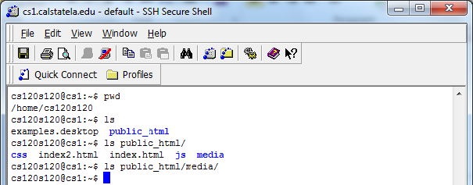
The Path
Use the folder name and a forward slash (/) to add a path to a file.
Can use this to access files and locations outside the terminal window.
Use . (single dot) and .. (double dot) to access the current directory and parent directory
Can combine multiple folders into one path
“ls ../”
Lists all files and folders within the parent directory

Slide 19
File Commands
The following are basic file commands to work with:
cp
mv
rm
These can include pathnames in order to access files and folders not in the current directory
There are many (many, many) more commands, but you really only need these for class

Slide 20
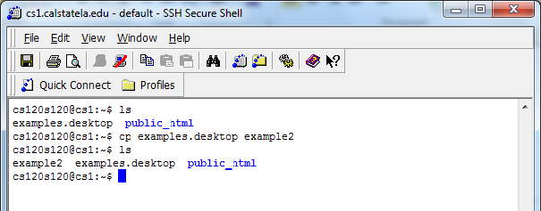
The cp Command
“Copy”
Copies a file
cp [filename_to _copy] [name_of_copy]
Copies the first file to the second file.

Slide 21
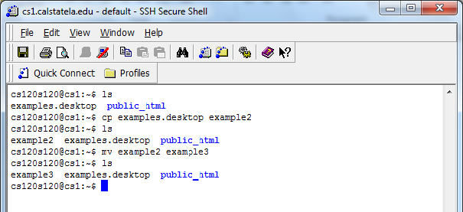
The mv Command
“Move”
Move a file from one place to another.
move [filename] [path][new_filename]
If there is no path specified, this becomes a file rename

Slide 22
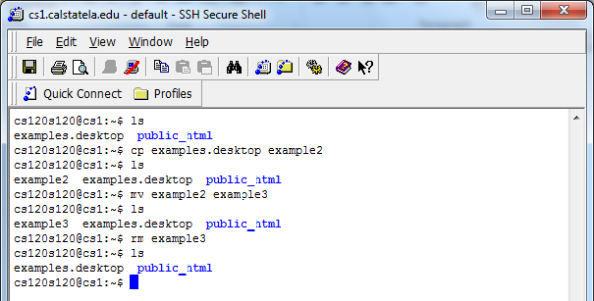
The rm Command
“Remove”
Deletes a file
rm [filename]

Slide 23
Extra Commands
Fancy things:
man [command_name]
View the built in manual for a command
cd ~
Move the terminal to your top level folder
more [filename]
Display the contents of a (text) file
You can also use built in text editors to edit your files remotely.
Nano
We will cover this editor
Emacs, Vi are others

Slide 24
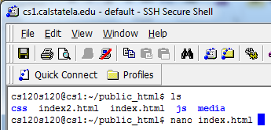
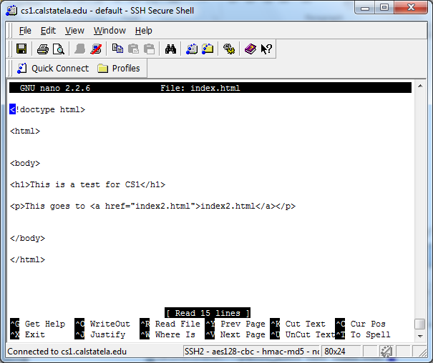
The Nano Editor
Type in nano [filename]
If [filename] exists it will edit that file
If [filename] is new, it will create a new file

Slide 25
The Nano Editor (2)
You will not be able to use the mouse in this editor – you will have to use the keyboard only.
Use the arrow keys to navigate
The commands at the bottom require you to hold down the “control” (ctrl) key first.
Ctrl + x Exit
Ctrl + o Save (write out)
Ctrl + k Cut text
Ctrl + u Paste (uncut text)
With this, you can edit files without having to move them back and forth (from your computer to CS1)

Slide 26
The Nano Editor (3)
There are other linux text editors (Emacs, vi)
They are very complex
Learn on your own (ask me about Emacs).

Slide 27
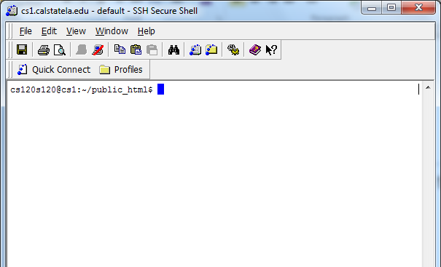
Transferring Files
Secure Shell Client also has a FTP (file transfer protocol) program that comes with it.
Click the yellow folder button to open it

Slide 28
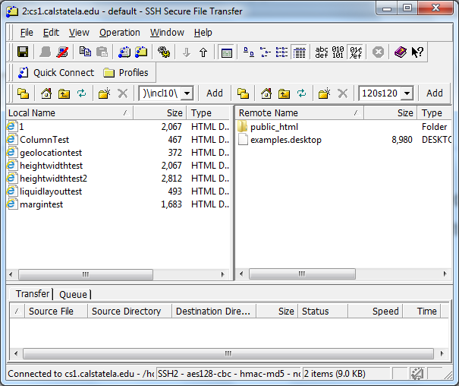
Transferring Files (2)
This open the Secure FTP client (program)
The left will list the file/folders of the computer you are using
The right side will list the file/folders of the remote folder (CS1)

Slide 29
Transferring Files (3)
Double click on each side to go to the files/folder you want.
Then drag and drop a file (or folder) from one side to the other to transfer the file(s).

Slide 30
Displaying Your Website
The URL for your website is:
http://cs1.calstatela.edu/~cs120sXX/
Where XX = your assigned account number
Go to this page to check your progress.
Note: The first page accessed in the folder is “index.html”
Realistically, when you type in:
http://cs1.calstatela.edu/~cs120sXX/
The browser is actually looking for:
http://cs1.calstatela.edu/~cs120sXX/index.html

Slide 31
Displaying Your Website (2)
Make sure you create your own CSS, Javascript and Media folders
Make all your CSS and Javascript external
Put your media (images, movies, audio) in the Media folder
Good luck!

